Slide 1
Distributed Systems Meet Economics: Pricing in the Cloud
Presented by Sachin Shubham

Slide 2
Introduction
Pricing as a bridge between provider and user.
Pay as you go model
Cloud provider have pricing scheme for users based on system usage
Pricing depends on two factors:
System design and optimization
Fairness and Competitive pricing
Studied conducted on by using two complementary approaches for evaluations:
A black-box approach with Amazon EC2.
Set up a cloud-computing testbed, called Spring

Slide 3
Background on Pricing
Factors impacting pricing:
Fairness:
Personal : Price meets user’s personal expectation.
Social : Price is same for all users.
Competition : provider cannot set their prices in a way most favorable to them. Instead, they gain a competitive advantage through adopting new technology and lowering their cost.

Slide 4
Pay-as-you-go Model :
the pricing scheme becomes an important bridge between users and providers.
Computing price based on virtual-machine hours.
Several alternative pricing schemes have been proposed for better system behavior in the cloud. E.g. Gurmeet and Karl suggested dynamic pricing on resource consumption.

Slide 5
Workloads
Postmark:
As an I/O-intensive benchmark, representing the file transactions for various web-based applications.
For experiment: the total file size is around 5 GB (1000 files, 5000 KB each); the number of transactions is 1000
PARSEC:
Benchmark suite for chip-multiprocessor
Composed of multithread programs
9 applications and 3 kernels
BlackScholes: High performancing compting
Dedup: Storage
For experiment: 184 MB input data for Dedup and 10 million options for Blackscholes

Slide 6
Contd…
Hadoop:
Use Hadoop 0.20.0 for large-scale data processing.
WordCount and StreamSort from the GridMix benchmark
For Experiment : Input dataset is 16 GB

Slide 7
Methodologies
Methodology on Amazon EC2:
Charged according to the pricing scheme of Amazon.
Calculate user expenses as Costuser = Price × t
t : the total running time of the task in hours,
Price: the price per virtual machine hour
Exclude the costs on storage and on data transfer between the client and the cloud
Methodology on the Spring System:
Physical data center and provides virtual machines to users.
Consists of two major modules, VMM (Virtual Machine Monitor) and an auditor
Provider Profit = Payment from user - Total provider cost

Slide 8
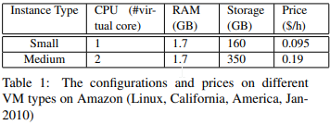
Experimental Setup in Amazon EC2
Two virtual-machine types provided by EC2: small and medium instances

Slide 9
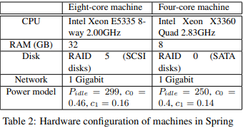
Experimental Setup in Spring
Use VirtualBox to implement a virtual machine in Spring.
The host OS is Windows Server 2003; the guest OS is Fedora 10.
An eight-core machine to evaluate the single-machine benchmarks, and a cluster consisting of 32 four-core machines to evaluate Hadoop.

Slide 10
Contd…
Power meter to measure the actual power consumption of a server
Estimating the total dollar cost based on Hamilton’s parameter settings
An Intel 80 GB X25-M SSD (Solid State Drives) to replace a SATA hard drive result in adjust the amortized cost in the machine with an SSD to $0.09 per hour.
system throughput=numbers of tasks finished per hour + user costs + provider profits
the efficiency of a provider’s investment:
ROI = Profit / Costprovider × 100%.

Slide 11
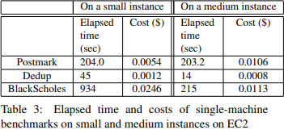
User Optimization on EC2
Focus on application-level optimizations for a fixed instance type, choosing the suitable instance type is important for both performance and cost.
Results indicates that choosing the suitable instance type for cost may not result in the best performance, and vice versa.

Slide 12
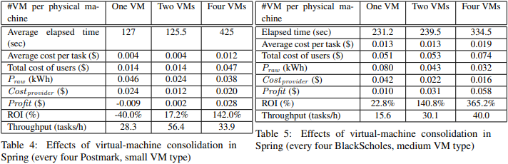
Provider Optimization on Spring
Focus on VM consolidation optimization by tune the number of concurrent VMs running on the same physical machine.
Smaller cost on small and medium VM types

Slide 13
Observations
Consolidation greatly reduces power consumption by 150% and 21% on Praw for BlackScholes and Postmark respectively.
As decrease in power cost and increase in user cost resulted in provider’s profit increases significantly(ROI increase 180% to 340%)
As more tasks are consolidated to the same physical machine, the throughput reaches a peak at consolidating two VMs with Postmark, and then degrades.
The system throughput can degrade up to over 64% compared with the peak

Slide 14
Pricing Fairness
Personal Fairness:
Users mostly need clarification on how they are charged and complaints on charging too high for certain scenarios.
Indicate personal unfairness in the pricing scheme.
Social Fairness:
As more VMs are consolidated onto the same physical machine, users pay more money for the same task
The cost variations on both Amazon and Spring indicate social unfairness of the current pricing scheme

Slide 15
Conclusion
By embracing a pricing scheme that connects providers with users, cloud computing has managed to bridge between distributed systems and economics.
The experiment conducted on Amazon EC2 and spring shows that the cost variation on both result in social as well as personal unfairness of the current pricing scheme.
Providers need to tune its pricing scheme to balance between their profit and user.

Slide 16


Slide 17


